Slide 1

ENGINEERING GRAPHICS
By
R.Nathan
Assistant Professor
Department of Mechanical Engineering
C.R.ENGINEERING COLLEGE
Alagarkovil, Madurai - 625301
I - SEMESTER LECTURE NOTES

Slide 2
UNIT – 4
“DEVELOPMENT OF SURFACES”
Engineering Graphics GE - 2111
C.R.ENGINEERING COLLEGE
Alagarkovil, Madurai - 625301
I - SEMESTER LECTURE NOTES

Slide 3
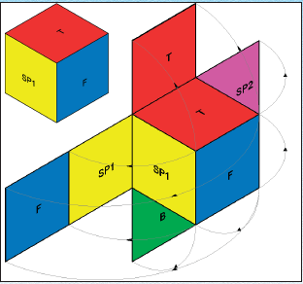
Engineering Graphics GE - 2111
DEVELOPMENT OF SURFACE
DEFINITION :-
PROCESS OF UNFOLDING OF SURFACES OF A SOLIDS OF A SOLID
C.R.ENGINEERING COLLEGE
Alagarkovil, Madurai - 625301
I - SEMESTER LECTURE NOTES

Slide 4
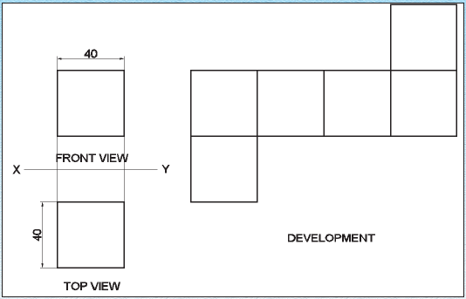
Engineering Graphics GE - 2111
DEVELOPMENT OF CUBE
Draw the development of surface of a cube of side 40 mm
C.R.ENGINEERING COLLEGE
Alagarkovil, Madurai - 625301
I - SEMESTER LECTURE NOTES

Slide 5
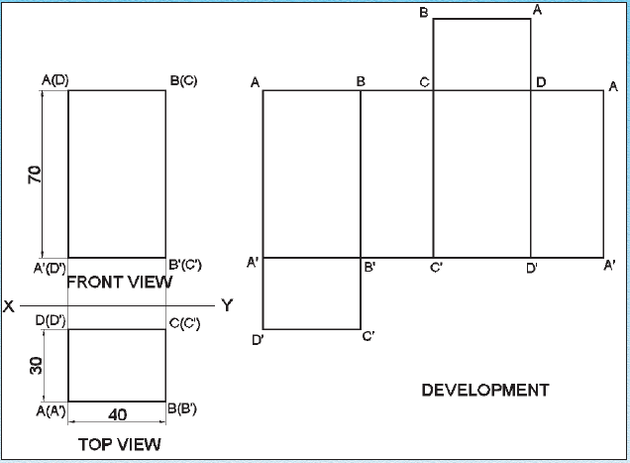
Engineering Graphics GE - 2111
DEVELOPMENT OF CUBOID
Draw the development of a cuboid of sides 70mm, 40mm & 30 mm (l x b x t)
C.R.ENGINEERING COLLEGE
Alagarkovil, Madurai - 625301
I - SEMESTER LECTURE NOTES

Slide 6
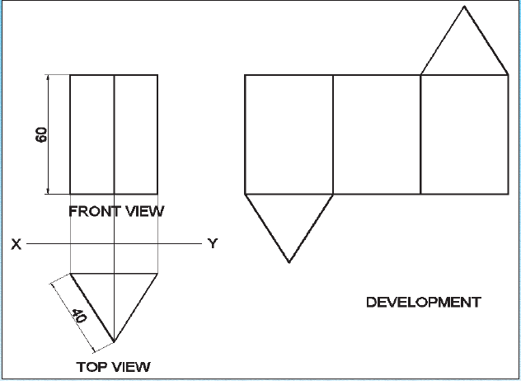
Engineering Graphics GE - 2111
DEVELOPMENT OF PRISM
Draw the development of a triangular prism of 40 mm base edge and 60 mm long height
C.R.ENGINEERING COLLEGE
Alagarkovil, Madurai - 625301
I - SEMESTER LECTURE NOTES

Slide 7
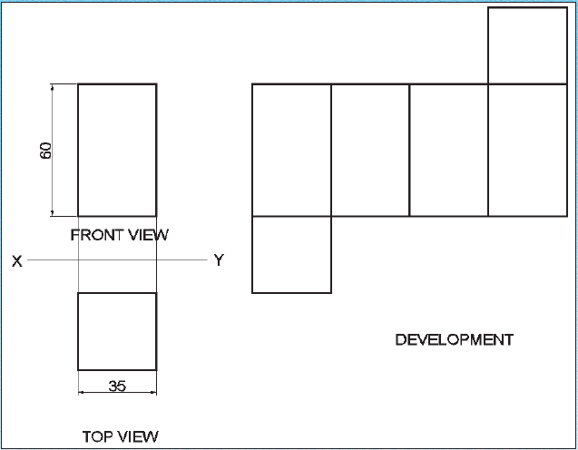
Engineering Graphics GE - 2111
DEVELOPMENT OF PRISM
Draw the development of a square prism of base side 35 mm and height of 60 mm
C.R.ENGINEERING COLLEGE
Alagarkovil, Madurai - 625301
I - SEMESTER LECTURE NOTES

Slide 8
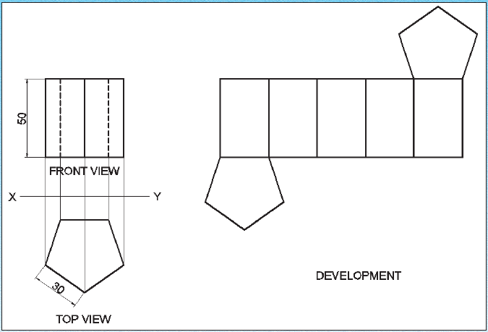
Engineering Graphics GE - 2111
DEVELOPMENT OF PRISM
Draw the development of a pentagonal prism 30 mm base edge and 50 mm long axis
C.R.ENGINEERING COLLEGE
Alagarkovil, Madurai - 625301
I - SEMESTER LECTURE NOTES

Slide 9
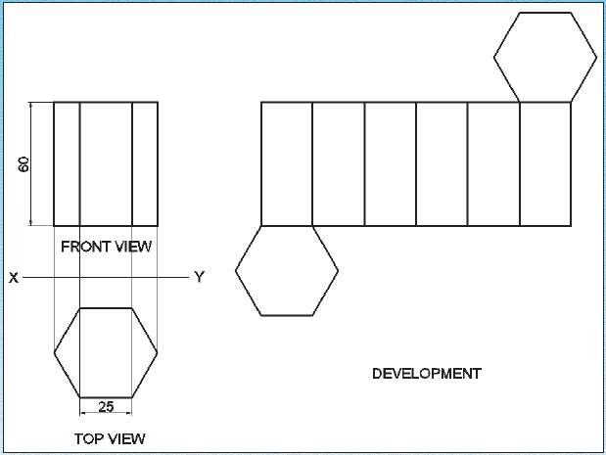
Engineering Graphics GE - 2111
DEVELOPMENT OF PRISM
Draw the development of a hexagonal prism of base edge 25 mm and axis 60 mm long
C.R.ENGINEERING COLLEGE
Alagarkovil, Madurai - 625301
I - SEMESTER LECTURE NOTES

Slide 10
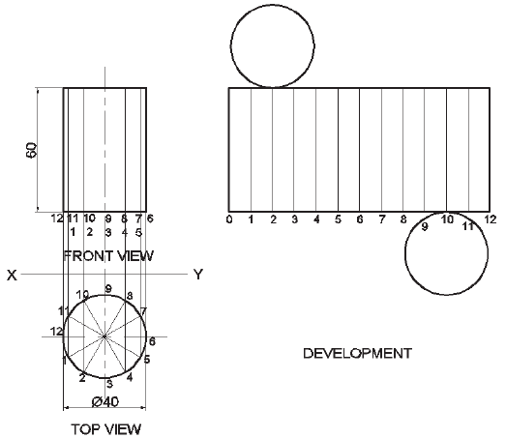
Engineering Graphics GE - 2111
DEVELOPMENT OF CYLINDER
Draw the development of a cylinder of 40 mm diameter and 60 mm high
C.R.ENGINEERING COLLEGE
Alagarkovil, Madurai - 625301
I - SEMESTER LECTURE NOTES

